Slide 1


Final year Project/Internship_PIP4005– 1st Review
Industrial Training on Embedded Systems at Techno Fly
Submitted to the Presidency University, Bengaluru in partial fulfillment of the requirements for the Degree of BACHELOR OF TECHNOLOGY in Electronics and Communication ENGINEERING
By
Under the supervision of
Mr. Syed Abrar Ahmed
Department of Electronics And Communication
February, 26/2026

Slide 2
Content
1.Abstract/About company
2.Literature Survey/Company and its legacy
3.Objectives and Working domain and technology
4.Hardware Details

Slide 3
Abstract
Techno Fly is a technology-based training and development company focused on providing practical knowledge in Embedded Systems, IoT, Robotics, and VLSI.
Established with the vision of bridging the gap between academics and industry.
Focuses on real-time project development.
Specializes in Embedded Systems training using industry-standard tools.

Slide 4
Literature Survey/Company and its Legacy
Literature Survey
Embedded systems are widely used in:
-Automotive systems
-Medical equipment
-Industrial automation
Company Legacy
Successfully trained 1000+ students.
Strong expertise in:
  -Arduino-based systems
  -ARM-based systems
  -Raspberry Pi projects
  -IoT applications

Slide 5
Objectives
To provide practical knowledge in Embedded Systems.
To train students in real-time hardware interfacing.
To improve programming skills in Embedded C.
To develop industry-ready engineers.

Slide 6
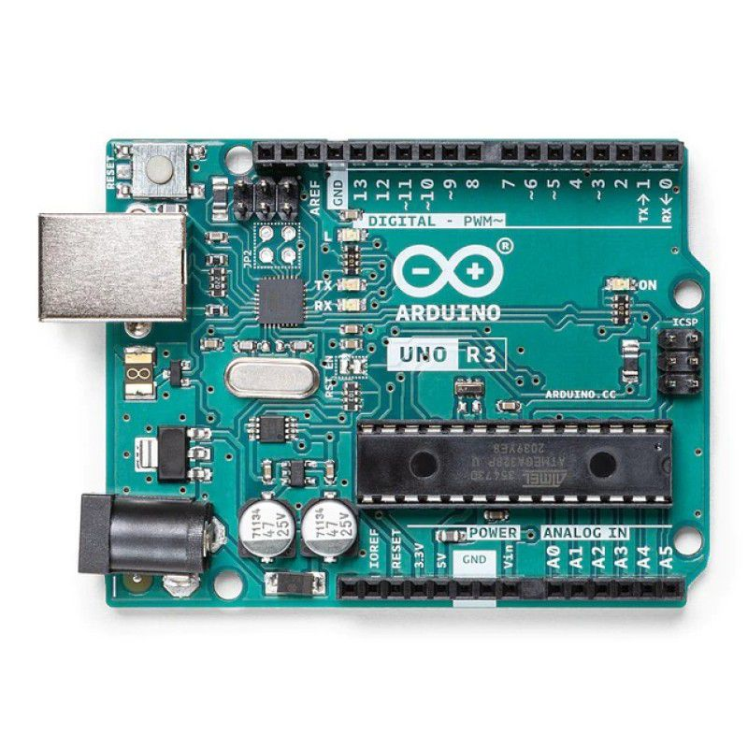
Hardware Details
Arduino Uno
8051 Development Board
Sensors (Temperature, Ultrasonic, IR, LDR)
DC Motors and Servo Motors
Power Supply Unit

Slide 7
Thank You !!!

